Slide 1
Google Analytics Prediction challenge #4
Vraj Desai

Slide 2
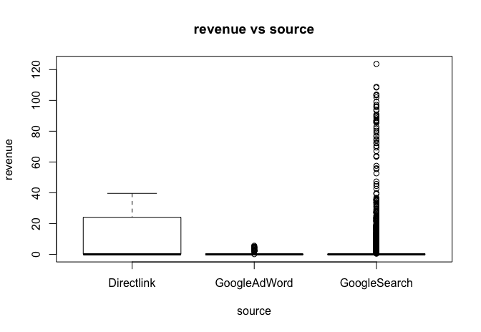
Intuition
More time spent on website = higher chances of something being bought
Does higher time = higher revenue?
Less activity = higher chances of something being bought
Less activity = more revenue?
Direct link or Google Search = higher chances of something being bought
3 types of sources -> Google Search, Google Ad and Direct Link
Test out all three separately to confirm

Slide 3
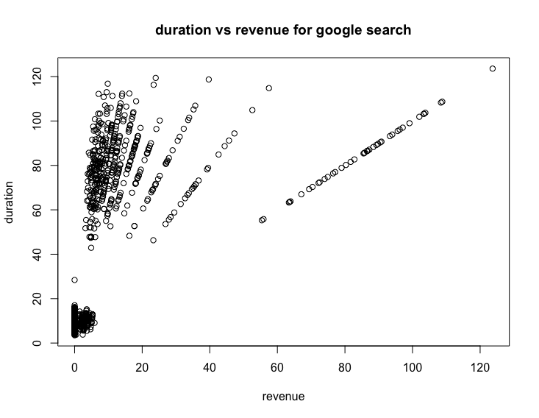
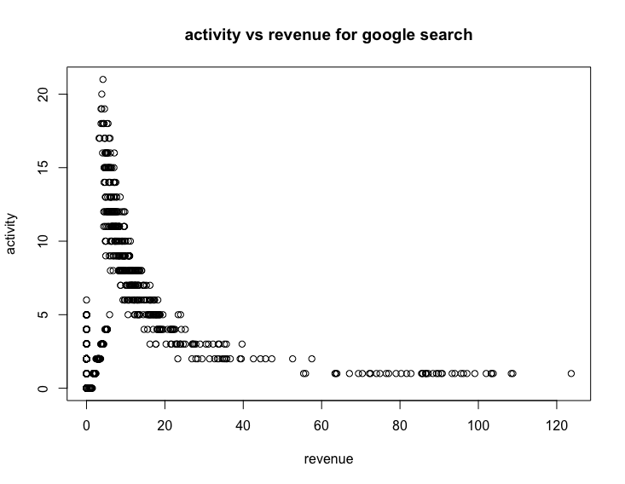
Plotting... Just Google Search
General trend of more duration spent on Google search, the higher chances of a purchase
Less activity = more revenue
Buyer must know how to get to the site, but has hard time deciding on product once on website

Slide 4
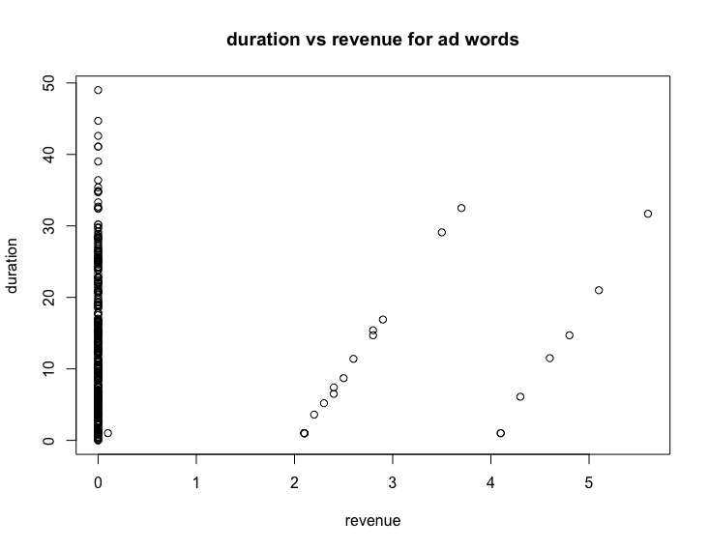
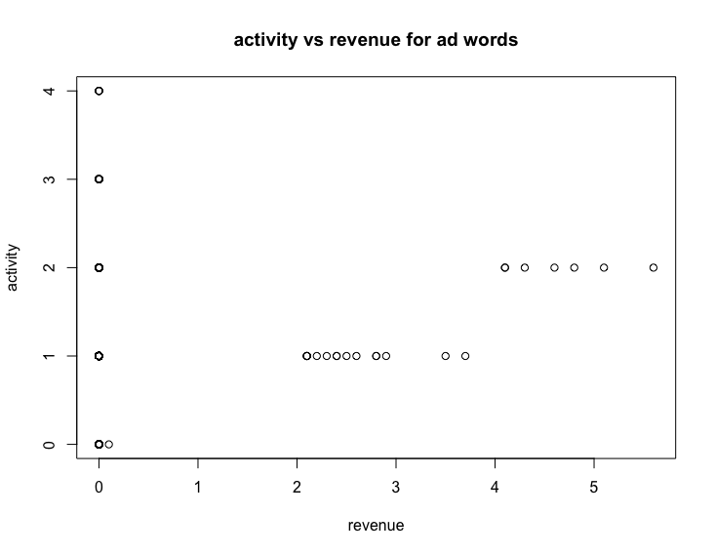
Plotting... Just Google Ads
General trend is that usually google ads do not produce much revenue no matter what duration and activity amount is

Slide 5
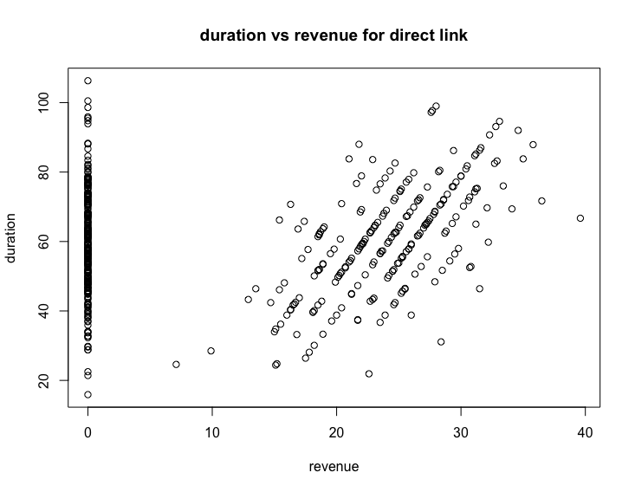
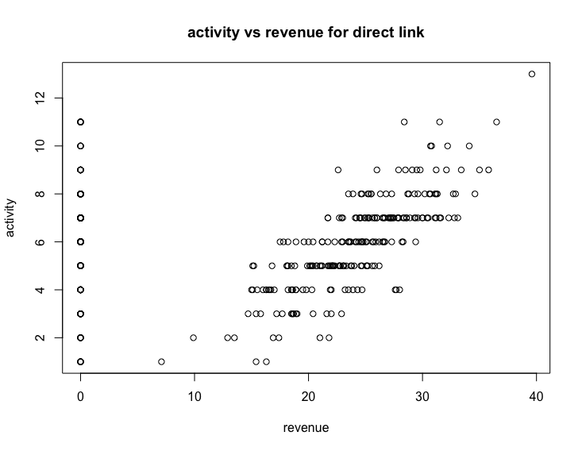
Plotting... Just Direct link
Most of the time, direct links will lead to revenue no matter what the duration or activity time is
As more activity is taken on the direct link, the revenues increase
Duration leads to more revenue

Slide 6
Conclusion on factors on Revenue
Revenues are greater whenever the source is Google Search or Direct Link
Google Ad Words do not lead to large amounts of revenue no matter activity and duration
Generally, the more activity and duration spent, the higher revenues are achieved

Slide 7
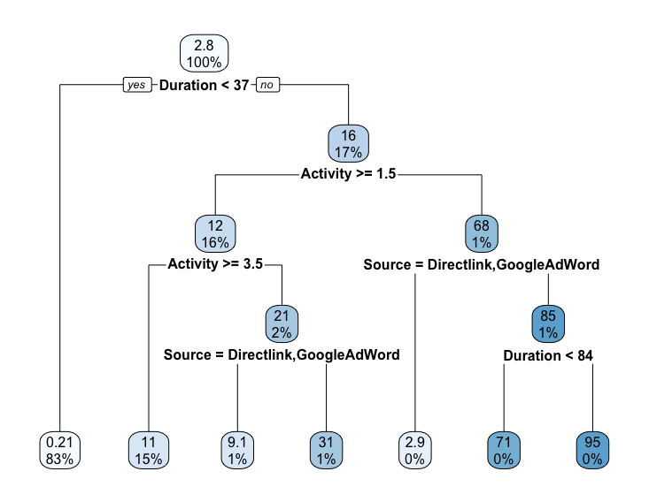
Decision Tree

Slide 8
Prediction & Error
All factors will be playing an important role in determining the revenues for the company
For error, I used linear modeling:
train.tree.v <- rpart(Revenue~ Activity + Duration + Source, data=P5_train1)
pred.tree.v <- predict(train.tree.v,newdata=P5_test_students)
mean((pred.tree.v - P5_test_students$Revenue)^2)
3.919819e-30
train.lm.v <- lm(Revenue~ Activity + Source + Duration, data=P5_train1)
pred.lm.v <- predict(train.lm.v,newdata=P5_test_students)
mean((pred.lm.v - P5_test_students$Revenue)^2) and MSE
40.30519

Slide 9
Cross Validation
Using prediction and error through MSE is not enough
To confirm accuracy, I performed cross validation and ended up with a very low accuracy of around
1 25.60251 25.60251
2 16.44242 16.44242
This is the closet I could achieve with all the plots and such I have focused on
I may be missing more data, but it is tough purely predicting numerical numbers and finding a pattern

Slide 10
Conclusion
So from this analysis, it is tough to conclude, but somewhat evident that source and duration are important factors into whether there is a high revenue or even any revenue at all
Less action and duration almost always equal to no revenue no matter what the source is

